Slide 1

Presenter : Vasavi Hegde
Visualizing the World's Billionaires in 2022

Slide 2

Introduction
Billionaires have an excessive impact on the global economy, politics, and philanthropy. This project is an attempt to showcase how the billionaire’s companies and products stimulate the economic growth of a nation worldwide.
Dataset chosen in the project comprises of the Forbes World’s Billionaire list based on a snapshot of wealth using stock prices and exchange rates from March 11, 2022. According to Forbes list, many billionaires are the founders of technology giants, with a large portion of their fortune still invested in the companies they founded.
Dataset is a CSV file containing the list of 2600 billionaires of the world, features include Rank, Name, Net worth, Age, Country, Source, and Industry of billionaires. I have attached the Dataset with the proposal document.
Notes:
Philanthropy: Many billionaires choose to give away a portion of their wealth to charitable causes. This can include funding research into diseases, supporting education initiatives, or building infrastructure in underserved areas

Slide 3
Project Objectives
The objective of this project is to explore and visualize the data of billionaires in 2022. The project aims to use Jupyter notebook in an incremental form to experiment and explore the code. Additionally, the project will leverage the NumPy and Pandas packages to load the large dataset.
Since the dataset is large, the project will use the Seaborn library and Matplotlib to plot the graph as it provides a high-level interface for plotting attractive and informative statistical graphs. Bar plots will be used to display the relationship between a numeric and a categoric variable.
The goal of the project is to visualize which industry has more billionaires and which country in the world has more billionaires according to the dataset. Histograms will be used to display the frequency distributions, such as the age distribution of billionaires.
The project will also visualize the number of billionaires by the number of income sources, country and its net worth, and industry and its net worth using a bar chart. The overall objective of the project is to provide interesting visualization facts about how billionaires and their industries contribute to the economic growth of nations in the world.

Slide 4
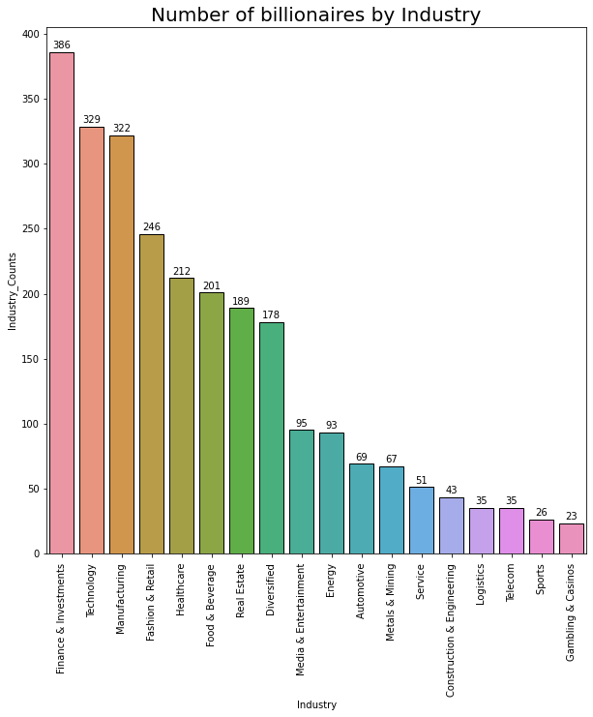
It is interesting to see the industries with the highest number of billionaires are Finance and Investment, Technology, Manufacturing, Fashion Detail and so on. Billionaires who own or invest in companies can help create jobs for people in their communities, which can have a positive impact on economies.

Slide 5
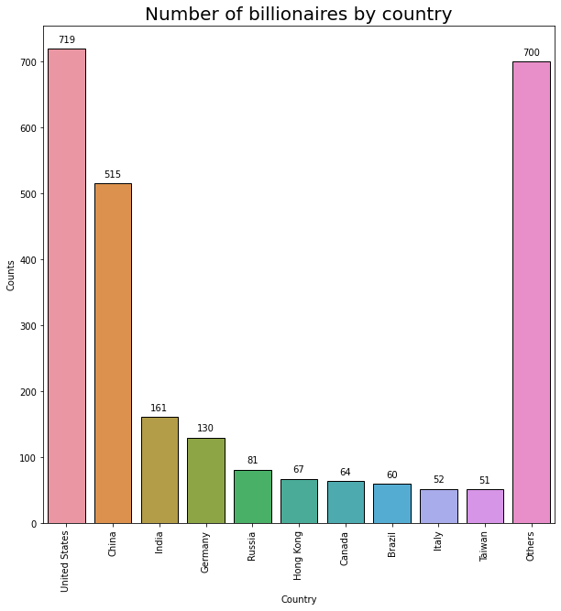
United States, China, India are having the highest billionaires worldwide.
Tax revenue: Billionaires who generate significant income or capital gains can also contribute to economic growth by paying taxes. This tax revenue can be used by governments to fund infrastructure projects, education, healthcare, and other initiatives that can support economic growth.
Notes:
United States, China, India are having the highest billionaires worldwide. Tax revenue: Billionaires who generate significant income or capital gains can also contribute to economic growth by paying taxes. This tax revenue can be used by governments to fund infrastructure projects, education, healthcare, and other initiatives that can support economic growth.

Slide 6
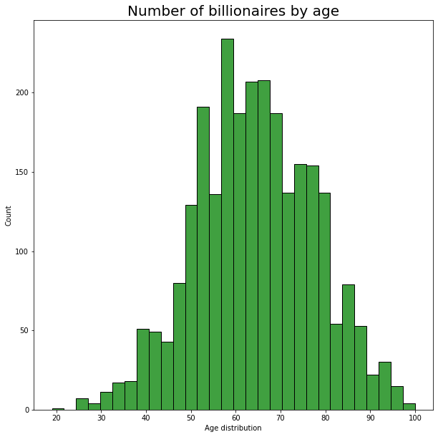
Notes:
The age group between 50-80 years old has the highest number of billionaires, according to Forbes' 2021 Billionaires List.

Slide 7
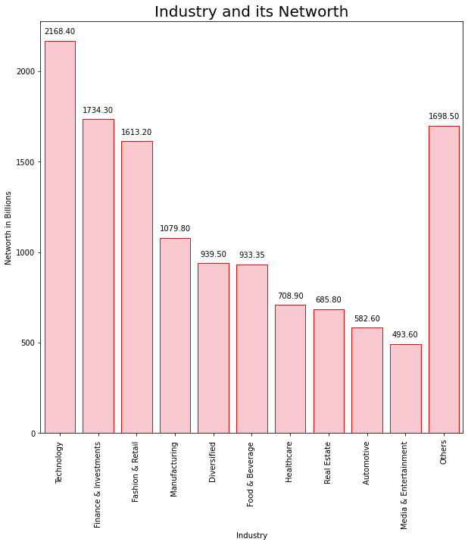

Slide 8
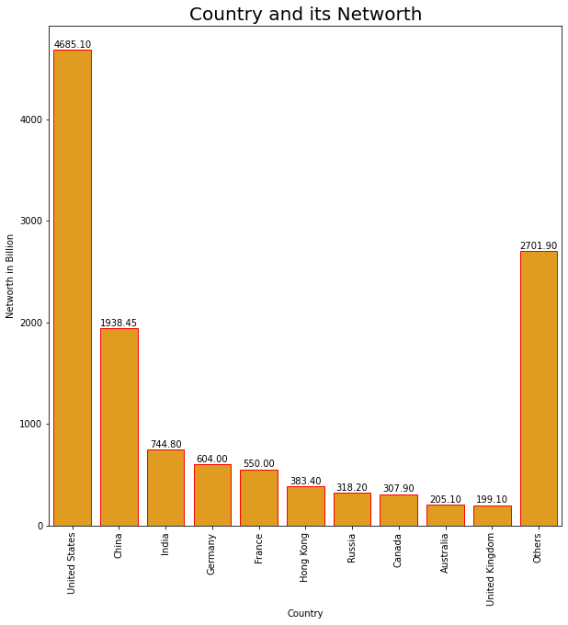

Slide 9
Insight
Job creation: Billionaires who own or invest in companies can help create jobs for people in their communities, which can have a positive impact on local economies.
Philanthropy: Many billionaires choose to give away a portion of their wealth to charitable causes. This can include funding research into diseases, supporting education initiatives, or building infrastructure in underserved areas.
Innovation: Some billionaires are responsible for breakthroughs in technology or other industries that have transformed society. For example, the founder of Amazon, Jeff Bezos, revolutionized e-commerce and has helped make online shopping more accessible to people around the world.
Investment: Billionaires can use their wealth to invest in companies that are working on solutions to some of the world's most pressing problems, such as renewable energy or clean water. This can help drive progress in important areas and benefit society as a whole.
Job creation: Billionaires who own or invest in companies can help create jobs for people in their communities, which can have a positive impact on local economies.
Philanthropy: Many billionaires choose to give away a portion of their wealth to charitable causes. This can include funding research into diseases, supporting education initiatives, or building infrastructure in underserved areas.
Innovation: Some billionaires are responsible for breakthroughs in technology or other industries that have transformed society. For example, the founder of Amazon, Jeff Bezos, revolutionized e-commerce and has helped make online shopping more accessible to people around the world.
Investment: Billionaires can use their wealth to invest in companies that are working on solutions to some of the world's most pressing problems, such as renewable energy or clean water. This can help drive progress in important areas and benefit society as a whole.

Slide 10

Thank you!

